Slide 1

Reconfigurable Formant and Inverse Formant Filters Using Current Feedback Operational Amplifiers
A unified CFOA topology for speech signal processing — minimizing component count while enabling full reconfigurability between resonator and anti-resonator functions.

Slide 2
Team &Guidance
Gurumurthy Komanapalli
23BEC7161 – Bana Yogini
23BEC7128 – K Akhila
23BEC7113 – Madhusri V

Slide 3

Introduction: Unpacking Formant Filters
Formant filters are crucial for shaping speech signals, acting as acoustic fingerprints. This presentation explores their significance in signal conditioning and the pivotal role of Current Feedback Operational Amplifiers (CFOAs) in creating highly reconfigurable and efficient filter designs.

Slide 4

Current Challenges in Formant Filter Design
Existing implementations demand distinct circuits for resonators and anti-resonators, significantly increasing design complexity and requiring separate topologies.
Peaking filter methods exacerbate this issue, requiring up to seven operational transconductance amplifiers (OTAs) for single functions, leading to excessive component counts and inefficiency.
This topological fragmentation and component overhead ultimately creates a critical design bottleneck in speech signal processing applications.

Slide 5
Motivation: The Need for Optimization
Existing speech signal processing systems often suffer from complexity due to a high component count, limiting their adaptability and practical deployment. Our motivation stems from the critical need for a unified, reconfigurable topology that not only minimizes hardware requirements but also maintains robust performance across diverse applications, from speech synthesis to telecommunications.

Slide 6
Project Objectives
Our research aims to address current limitations in speech signal processing by focusing on three key objectives:
1
2
3
Unified CFOA Topology
Validation & Implementation
Performance Benchmarking
Design a single Current Feedback Operational Amplifier (CFOA)-based topology capable of realizing both formant and inverse formant filters with minimal active elements.
Conduct a comprehensive comparison of the filter's performance against existing approaches to highlight its advantages.
Rigorously validate the proposed topology through detailed simulations and practical hardware implementation.

Slide 7
Literature Review: Filter Implementations
1
2
3
OTA-BASED
OP-AMP (SALLEN-KEY)
CFOA-BASED
Offers high tunability and flexibility, making them suitable for adaptive filter designs. However, they can introduce non-linearity issues and often require more complex control circuitry.
Known for their simplicity and ease of implementation, typically requiring fewer components. They are generally robust but offer limited tunability and can suffer from bandwidth limitations at higher frequencies.
Combines good linearity with wide bandwidth capabilities. They provide an excellent balance between tunability and component economy, offering reconfigurability for various filter functions.
Our survey highlighted the critical trade-offs in prior art, focusing on tunability, component economy, and bandwidth performance for effective filter design in speech processing.

Slide 8
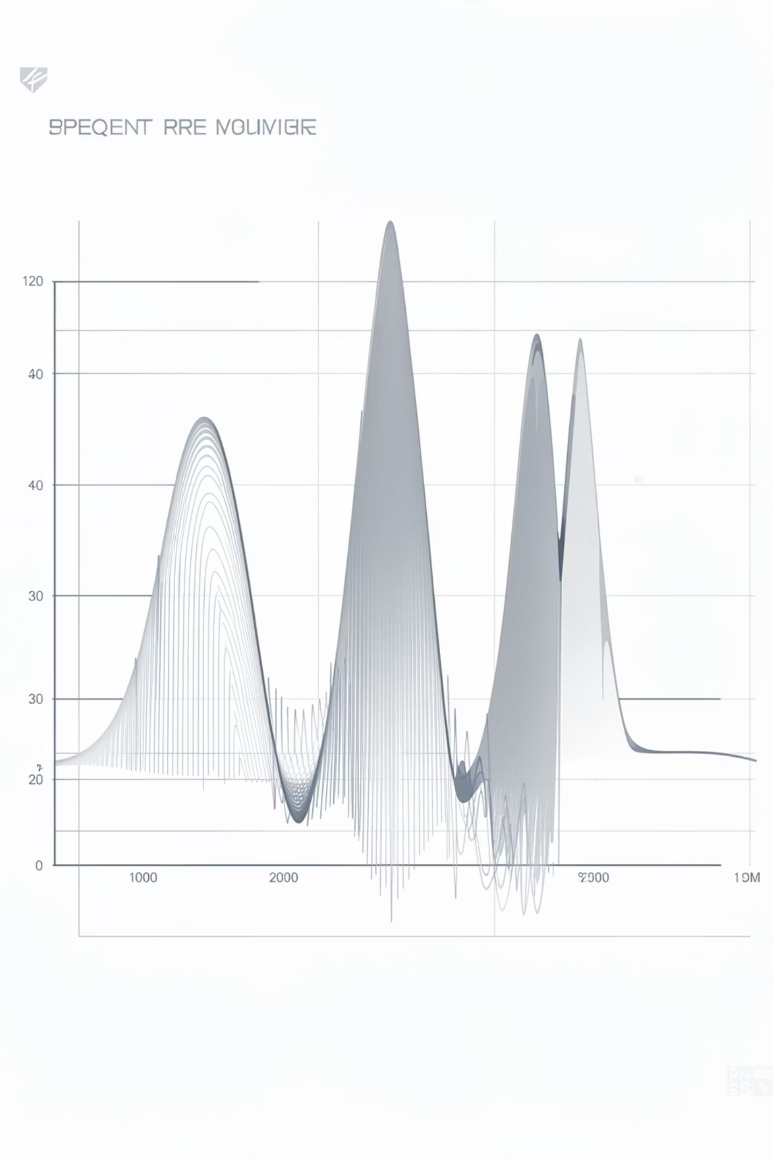
Technical Foundation: Formant Filters
Formant filters mimic vocal tract resonances, shaping speech by creating a frequency response with characteristic peaks—formants—essential for vowel production.
Inverse filters, or anti-resonators, perform the opposite function, suppressing these peaks. Their design relies on precise mathematical models to achieve accurate resonance and anti-resonance characteristics.

Slide 9

Key Components
AD844 Current Feedback Operational Amplifiers
Precision Resistors
Capacitors
Breadboard Prototyping Setup
These components form the foundation for our reconfigurable filter topology, enabling versatile speech signal processing.

Slide 10
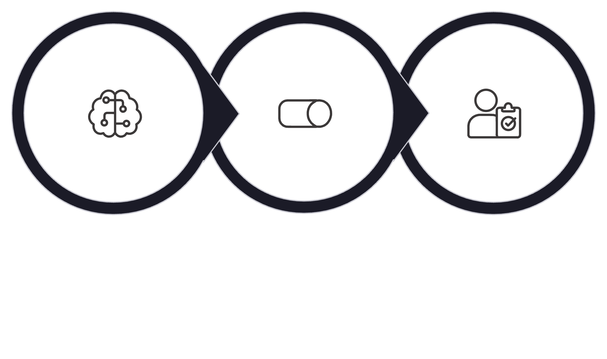
Proposed Methodology
Passive Reconfiguration
CFOA-MISO Design
PSpice & Hardware
Our methodology focuses on minimizing component count while ensuring full reconfigurability, validated by both rigorous simulation and practical hardware testing for robust performance.

Slide 11
Expected Outcomes & Conclusion
Our novel approach delivers significant advancements in reconfigurable filter design for speech processing.
Streamlined Topology
Validated Performance
Practical Applications
Unified resonator–anti-resonator design achieved a 50% reduction in active elements compared to previous CFOA methods.
Experimental frequency response precisely matches theoretical predictions, ensuring reliable and accurate operation.
The reconfigurable filters demonstrate high applicability and efficiency for modern speech processing systems.

